Slide 1


Performance Analysis of Fast-Food Companies in the Stock Market
Python for Data Science - Final Project
Team 4: Daniel Pace, Yanzhu Su, Benjamin Heist, Marios Contopoulos and Enric Cortés
December 2024

Slide 2
Data Pre-processing
Handling Missing Values Volume:
Missing values in the Volume column were filled using a rolling window mean with a window size of 7 days.
Price Columns (Open, High, Low, Close, Adj. Close):
Missing values in price-related columns were filled using a rolling median with a window size of 7 days.
1
2
Outlier Handling Price Columns:
Z-scores were calculated for each price column (Open, High, Low, Close, Adj Close). Any outliers with Z-scores greater than 3 or less than -3 were replaced with the rolling median value for that column.
Erroneous Data Correction Low vs. High:
If the value in the Low column was greater than or equal to the High column for any row, the erroneous Low value was replaced with the rolling mean of the Low values over the previous 7 days. If the rolling mean of Low was still higher than High, the Low value was adjusted to match the High value.
3
4
Handling Zero Volume Volume Zero:
If the Volume was zero for any row, and the Open, High, Low, or Close prices were different, the prices were replaced with the most frequent value (mode) in that row.
5
Duplicate Date Handling
Any duplicate dates in the dataset were identified, and if duplicates were found, they were printed out for further inspection
6
NaN Volume with Identical Prices
If a row had identical values in the price columns (Open, High, Low, Close) and Volume was missing, the missing Volume was replaced with 0.0.
Notes:
1. Handling Missing Values
Volume: Missing values in the Volume column were filled using a rolling window mean with a window size of 7 days.
Price Columns (Open, High, Low, Close, Adj Close): Missing values in price-related columns were filled using a rolling median with a window size of 7 days.
2. Outlier Handling
Price Columns: Z-scores were calculated for each price column (Open, High, Low, Close, Adj Close). Any outliers with Z-scores greater than 3 or less than -3 were replaced with the rolling median value for that column.
3. Erroneous Data Correction
Low vs. High: If the value in the Low column was greater than or equal to the High column for any row, the erroneous Low value was replaced with the rolling mean of the Low values over the previous 7 days. If the rolling mean of Low was still higher than High, the Low value was adjusted to match the High value.
4. Handling Zero Volume
Volume Zero: If the Volume was zero for any row, and the Open, High, Low, or Close prices were different, the prices were replaced with the most frequent value (mode) in that row.
5. Duplicate Dates
Duplicate Date Handling: Any duplicate dates in the dataset were identified, and if duplicates were found, they were printed out for further inspection.
6. NaN Volume with Identical Prices
If a row had identical values in the price columns (Open, High, Low, Close) and Volume was missing, the missing Volume was replaced with 0.0.

Slide 3
Dataset Summary
Dataset | Number of Rows | Number of Columns | Date | Open | High | Low | Close | Adj Close | Volume
BRK-A | 11227 | 7 | object | float64 | float64 | float64 | float64 | float64 | float64
DNUT | 815 | 7 | object | float64 | float64 | float64 | float64 | float64 | float64
DPZ | 5088 | 7 | object | float64 | float64 | float64 | float64 | float64 | float64
LKNCY | 1350 | 7 | object | float64 | float64 | float64 | float64 | float64 | float64
MCD | 14657 | 7 | object | float64 | float64 | float64 | float64 | float64 | float64
PZZA | 7883 | 7 | object | float64 | float64 | float64 | float64 | float64 | float64
QSR | 2459 | 7 | object | float64 | float64 | float64 | float64 | float64 | int64
SBUX | 8122 | 7 | object | float64 | float64 | float64 | float64 | float64 | float64
WEN | 11192 | 7 | object | float64 | float64 | float64 | float64 | float64 | float64
YUM | 6801 | 7 | object | float64 | float64 | float64 | float64 | float64 | float64

Slide 4
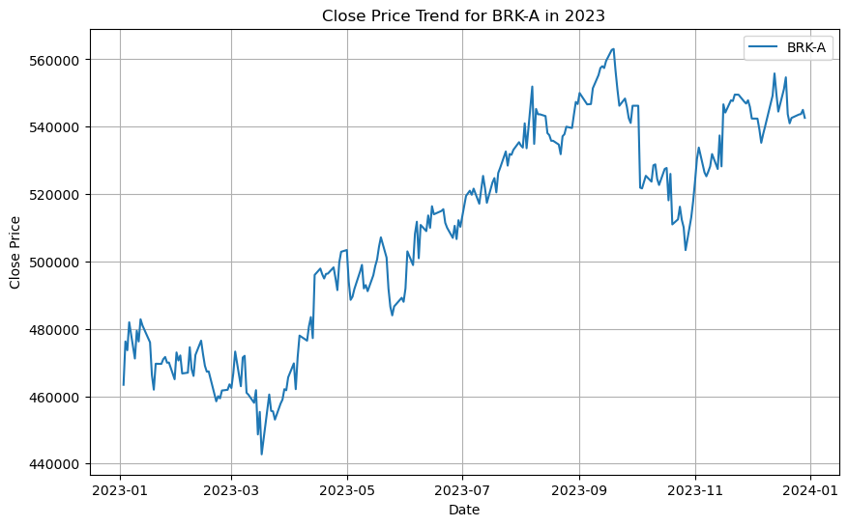
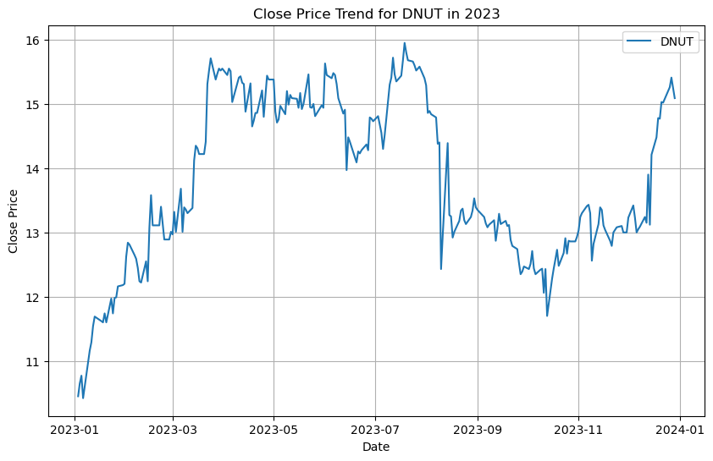
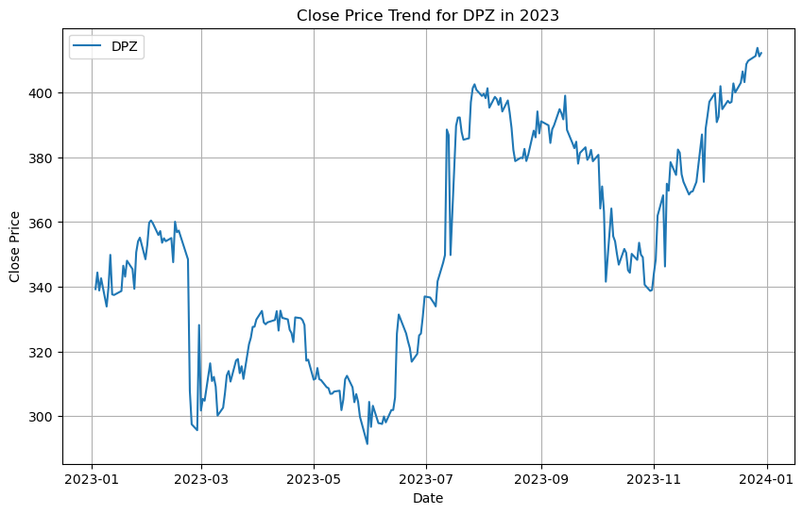
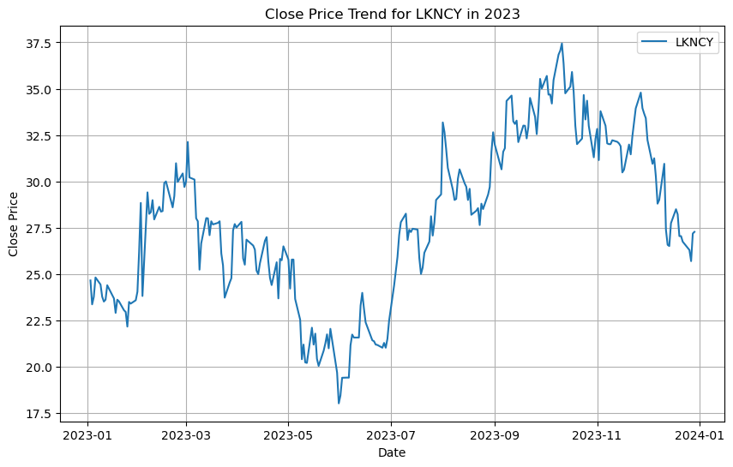
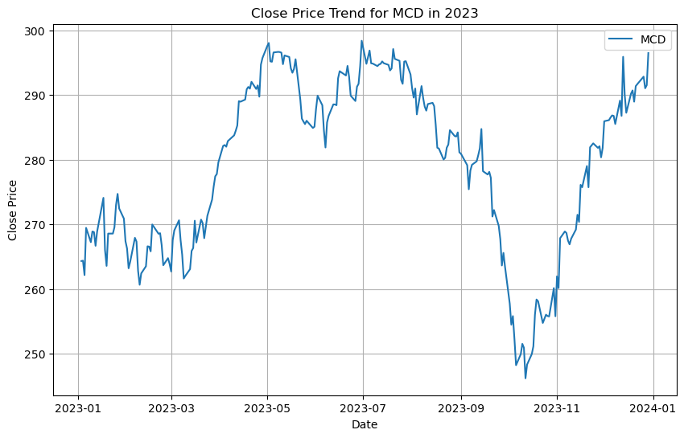
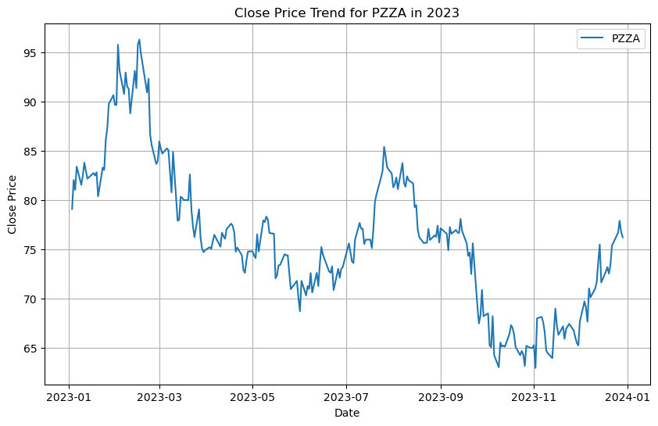
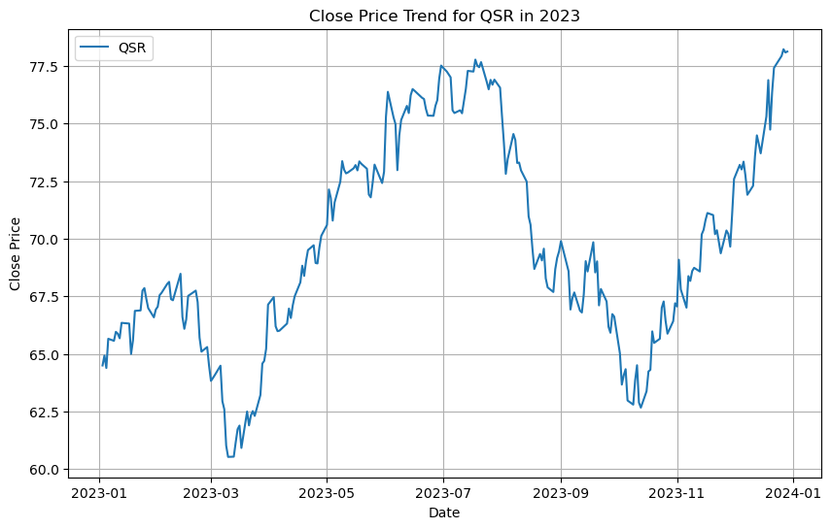
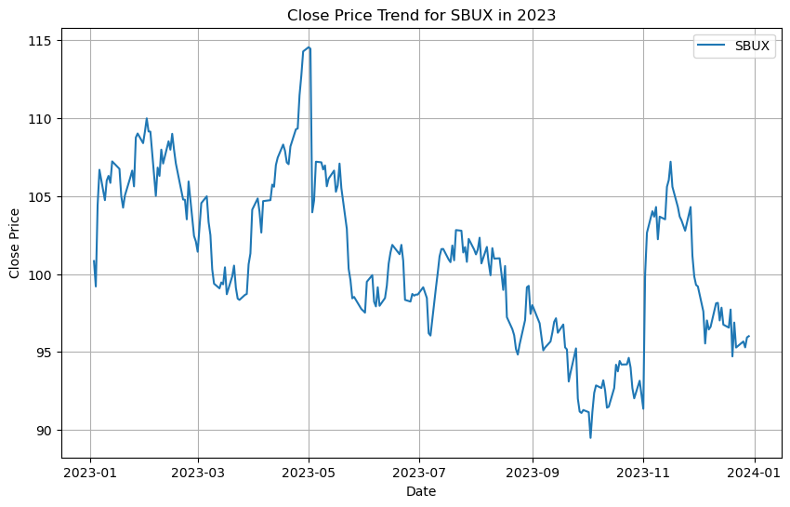
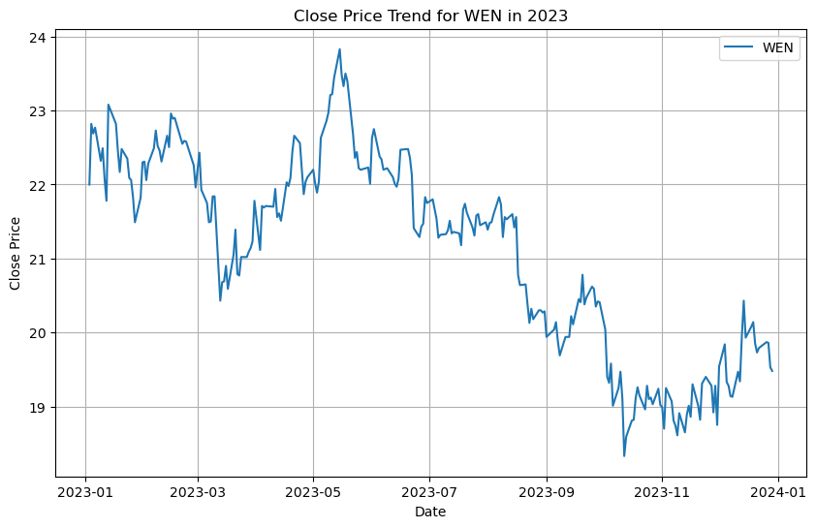
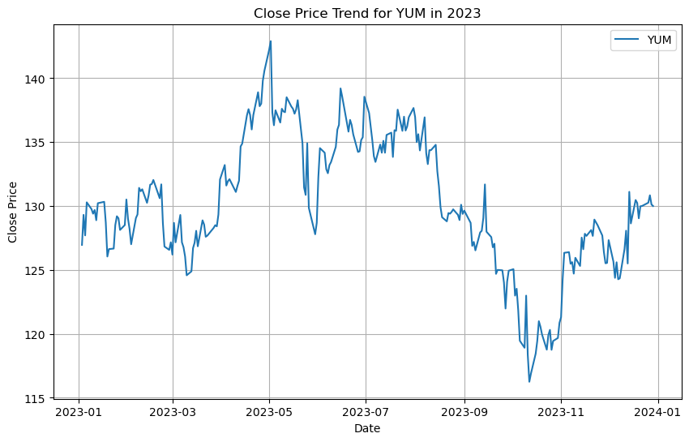
Close Price for 2023 and the Day with highest Close Price
Dataset | BRK-A | DNUT | DPZ | LKNCY | MCD | PZZA | QSR | SBUX | WEN | YUM
Highest Close Date | 03/09/2024 | 01/07/2021 | 31/12/2021 | 16/01/2020 | 19/01/2024 | 04/11/2021 | 13/03/2024 | 26/07/2021 | 07/05/1980 | 02/05/2023
Highest Close Price | 715910.000000 | 21.000000 | 564.330017 | 48.529999 | 300.529999 | 140.009995 | 82.750000 | 126.059998 | 63.396342 | 142.899994

Slide 5
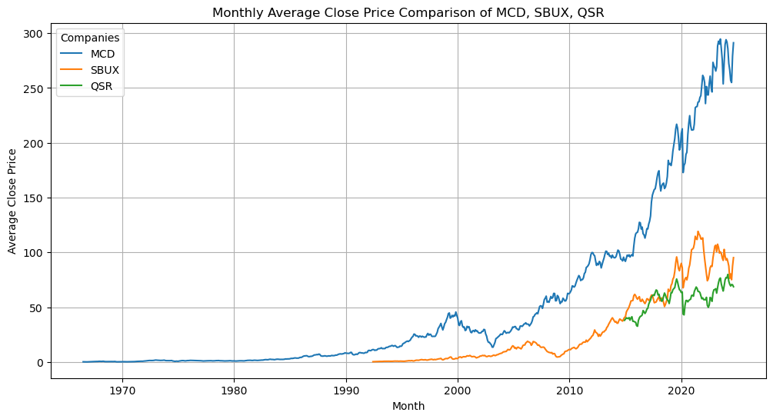
Monthly Average Close Price Analysis: MCD / SBUX / QSR
Selected companies:
McDonald’s
Starbucks
Restaurant Brands International
Why did we choose a line chart for the monthly average close price analysis?
Shows trends over time
Displays multiple datasets on the same plot without looking cluttered

Slide 6
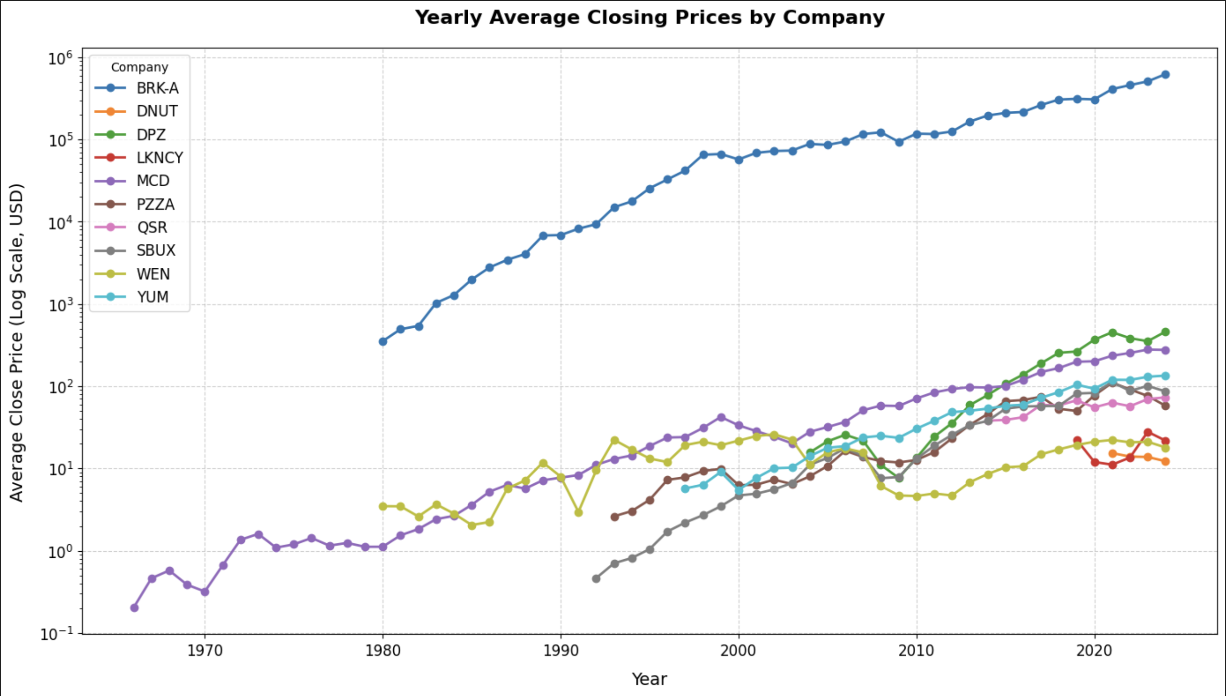
Analyzing Yearly Trends in Average Closing Prices
Why a line Chart?
Trend Visualization: Line charts effectively display trends over time, highlighting the progression of yearly average close prices.
Logarithmic Scale: A log scale ensures comparability between large and small values enabling fair comparisons.
Comparison Clarity: Distinct lines and markers make it easy to compare yearly trends without clutter.
Key Analysis
Trend Insights:
All companies have rising price patterns over time, except LKNCY/ BRK-A, though already having high prices, displays a similar growth rate / some companies (LKNCY, PZZA, MCD) seem to face decreasing stock prices in recent/upcoming years
Comparative Performance:
Companies like WEN and DNUT show slower or inconsistent trends, reflecting less stable growth.
Economic Impact:
The dip around 2008-2009 highlights the global financial crisis, affecting almost all companies before recovery. COVID led to a dip of some companies’ closing prices as well

Slide 7
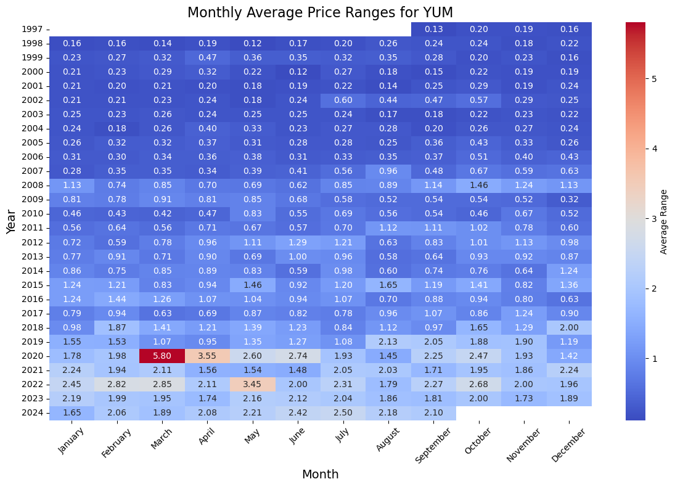
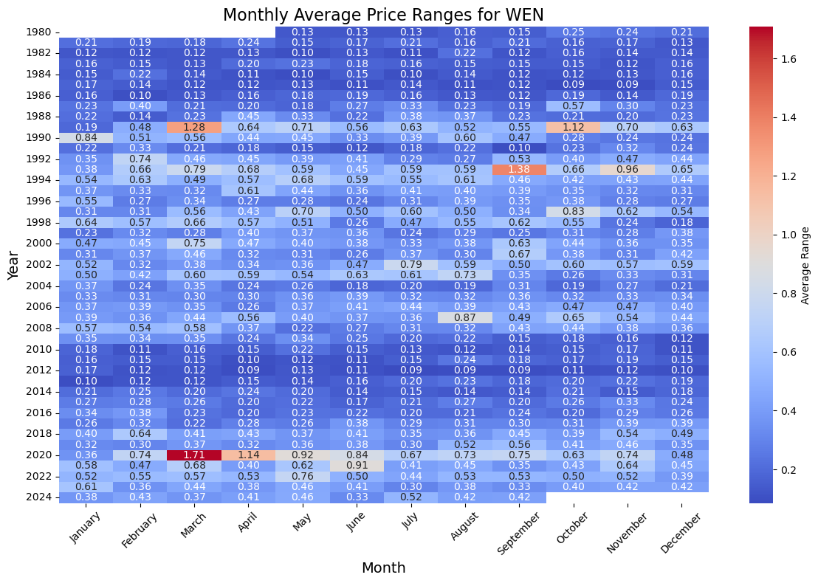
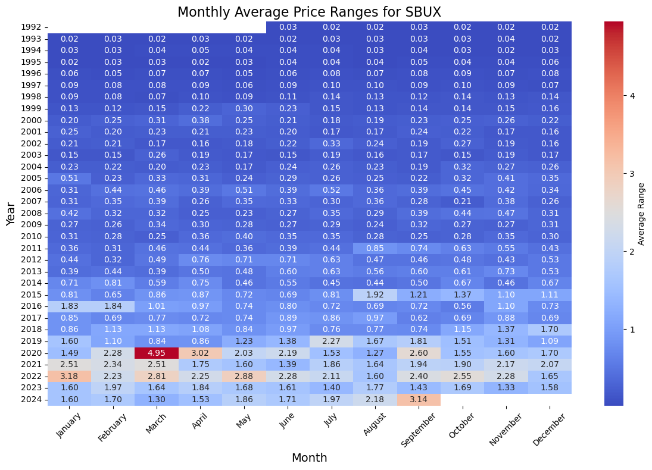
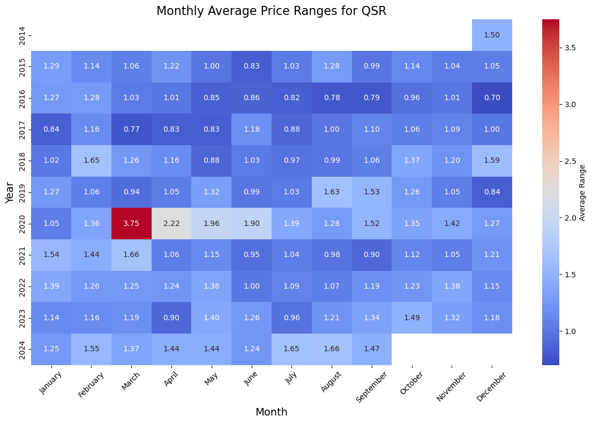
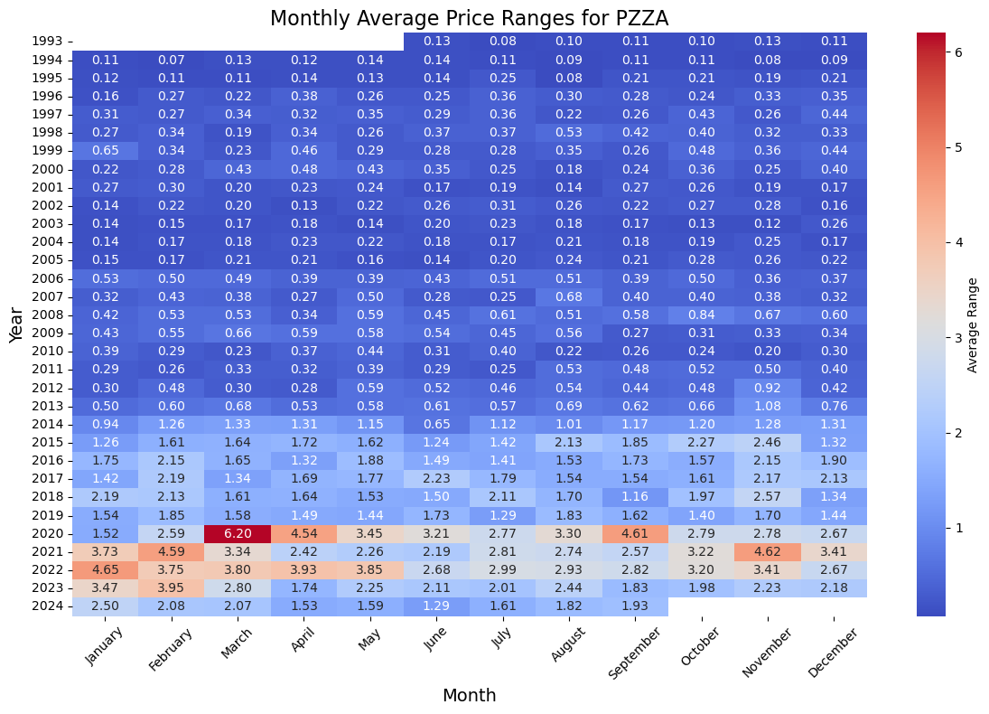
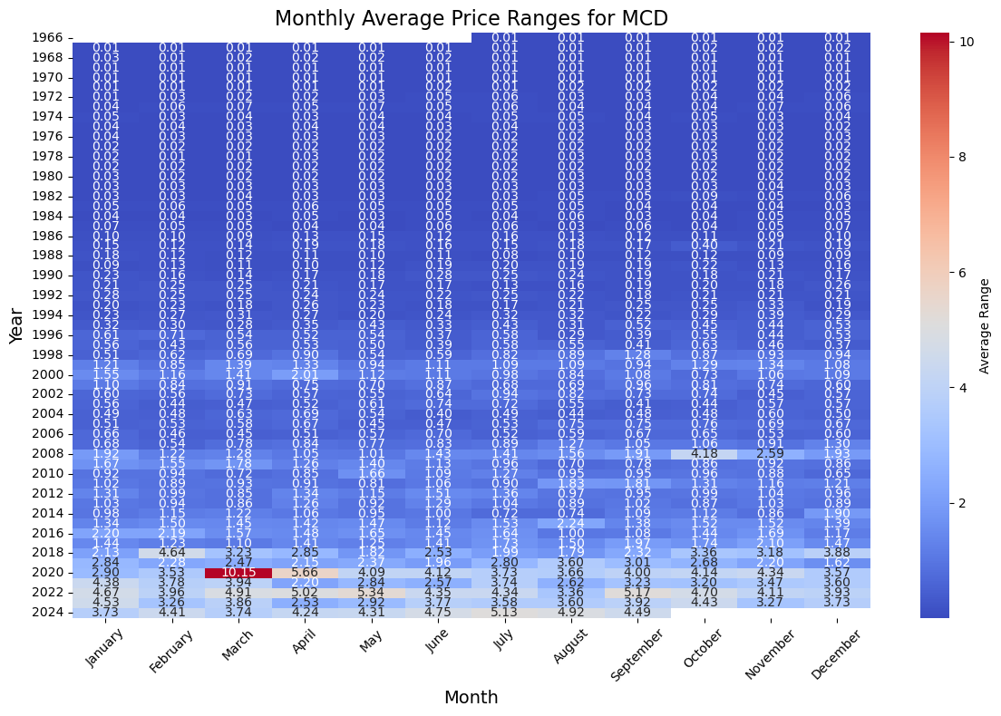
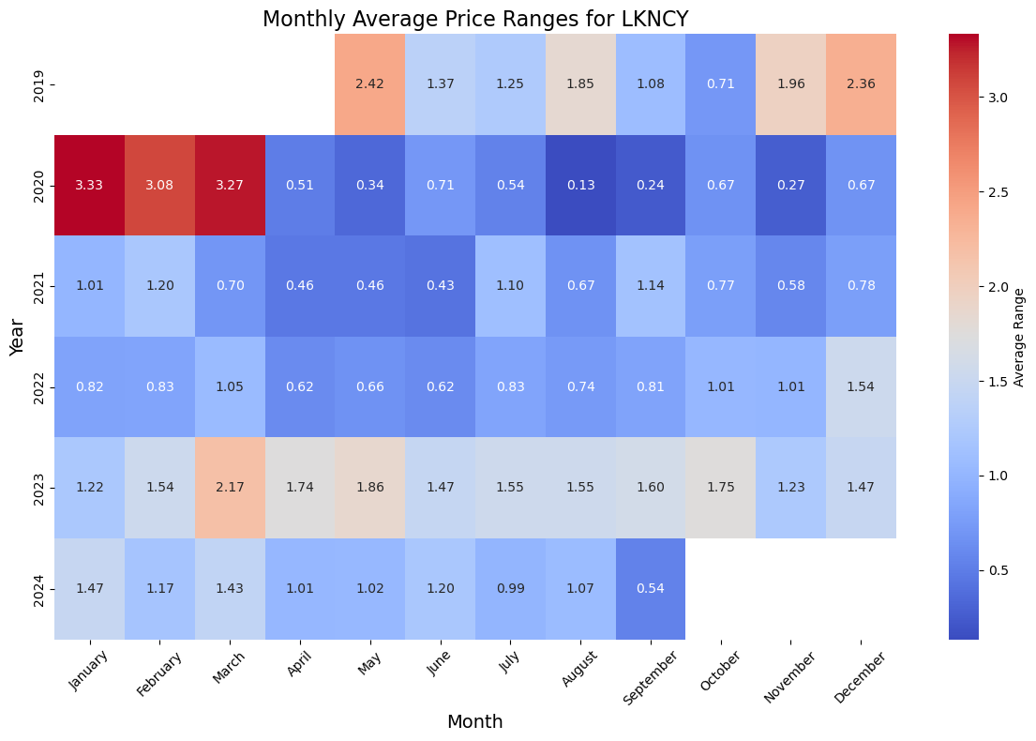
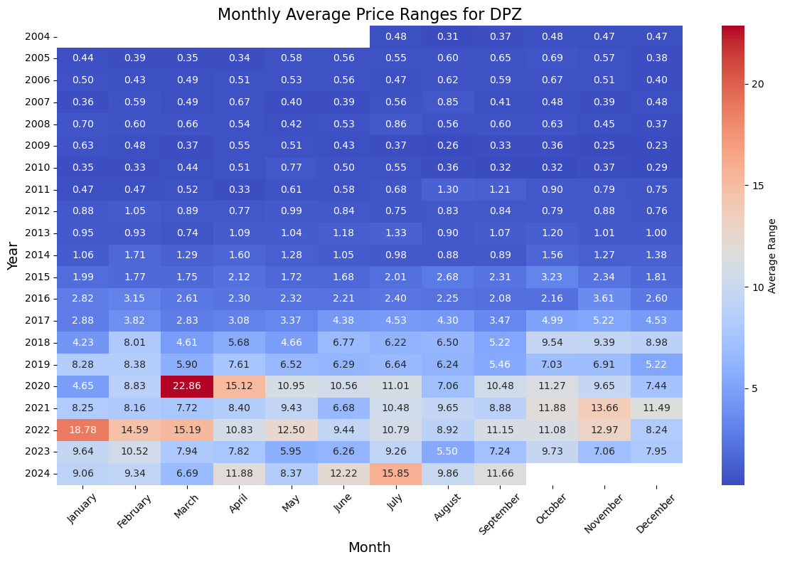
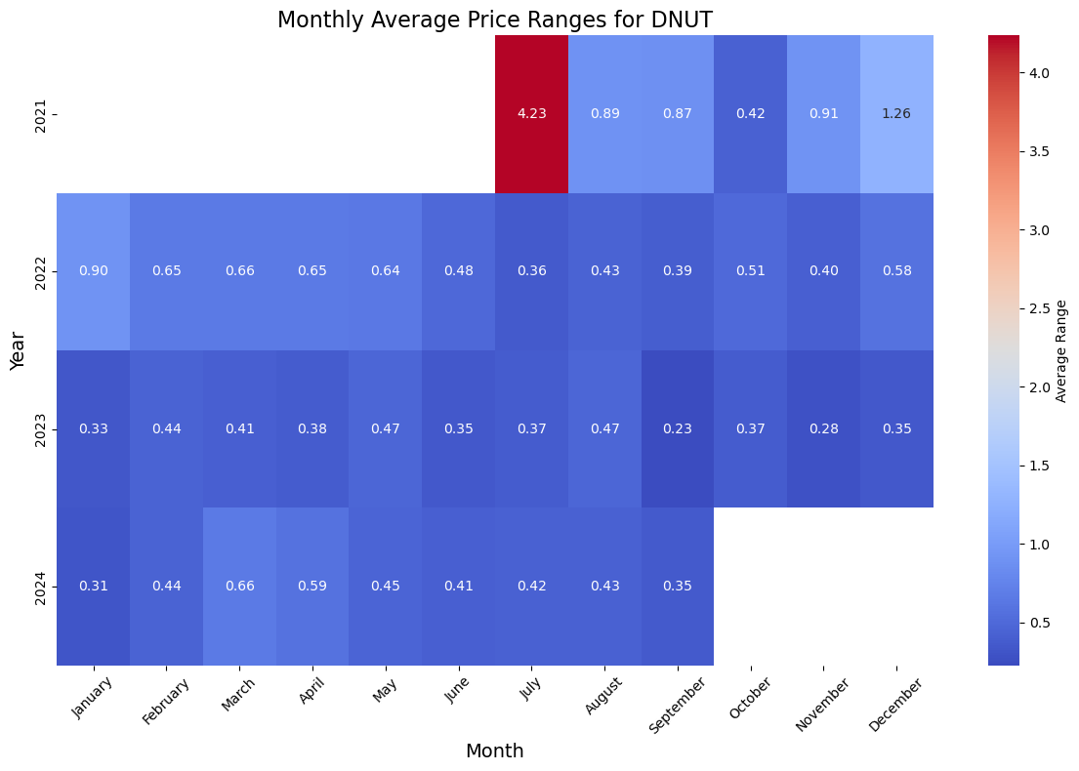
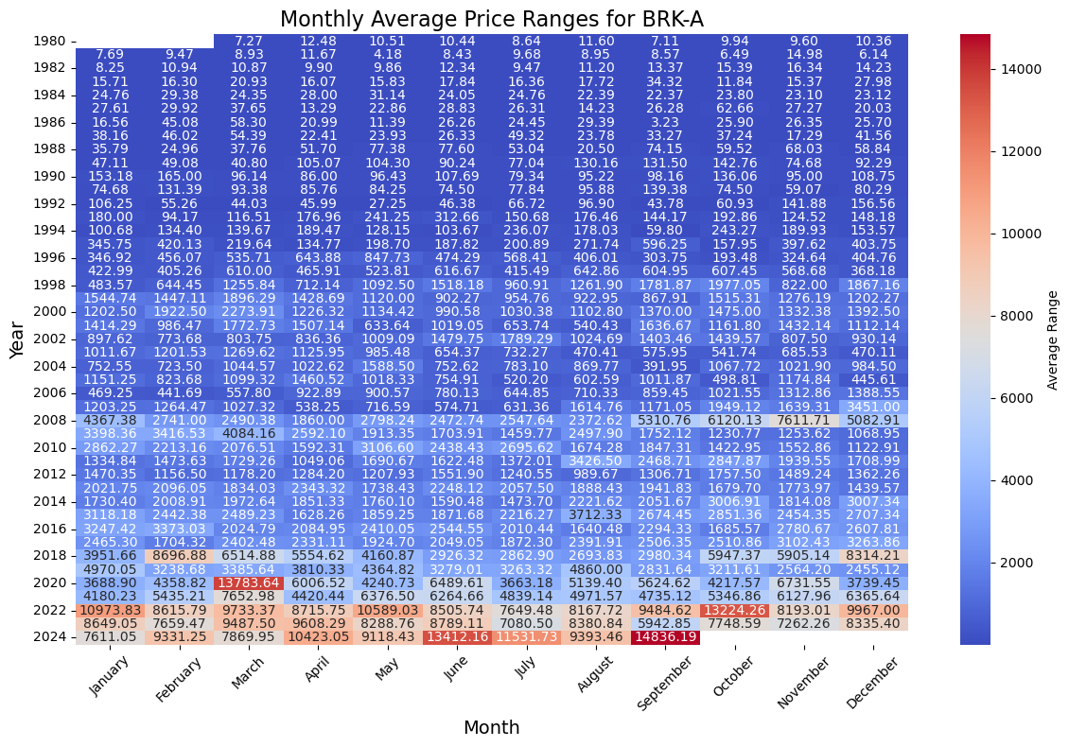
Monthly Price Range Visualization
Key advantages of using a heatmap for stock market price ranges
1. Time-Based Comparison:
It provides a simple format to read and understand even though there is a high magnitude of data.
2. Color Gradients Makes the complex data more intuitive by assigning colors.
3. Outlier Detection
You can easily identify unusual events like crashes or rallies and allows you to analyze potential causes such as earnings reports, economic announcements, or geopolitical events that match this unusual number on your heatmap.

Slide 8
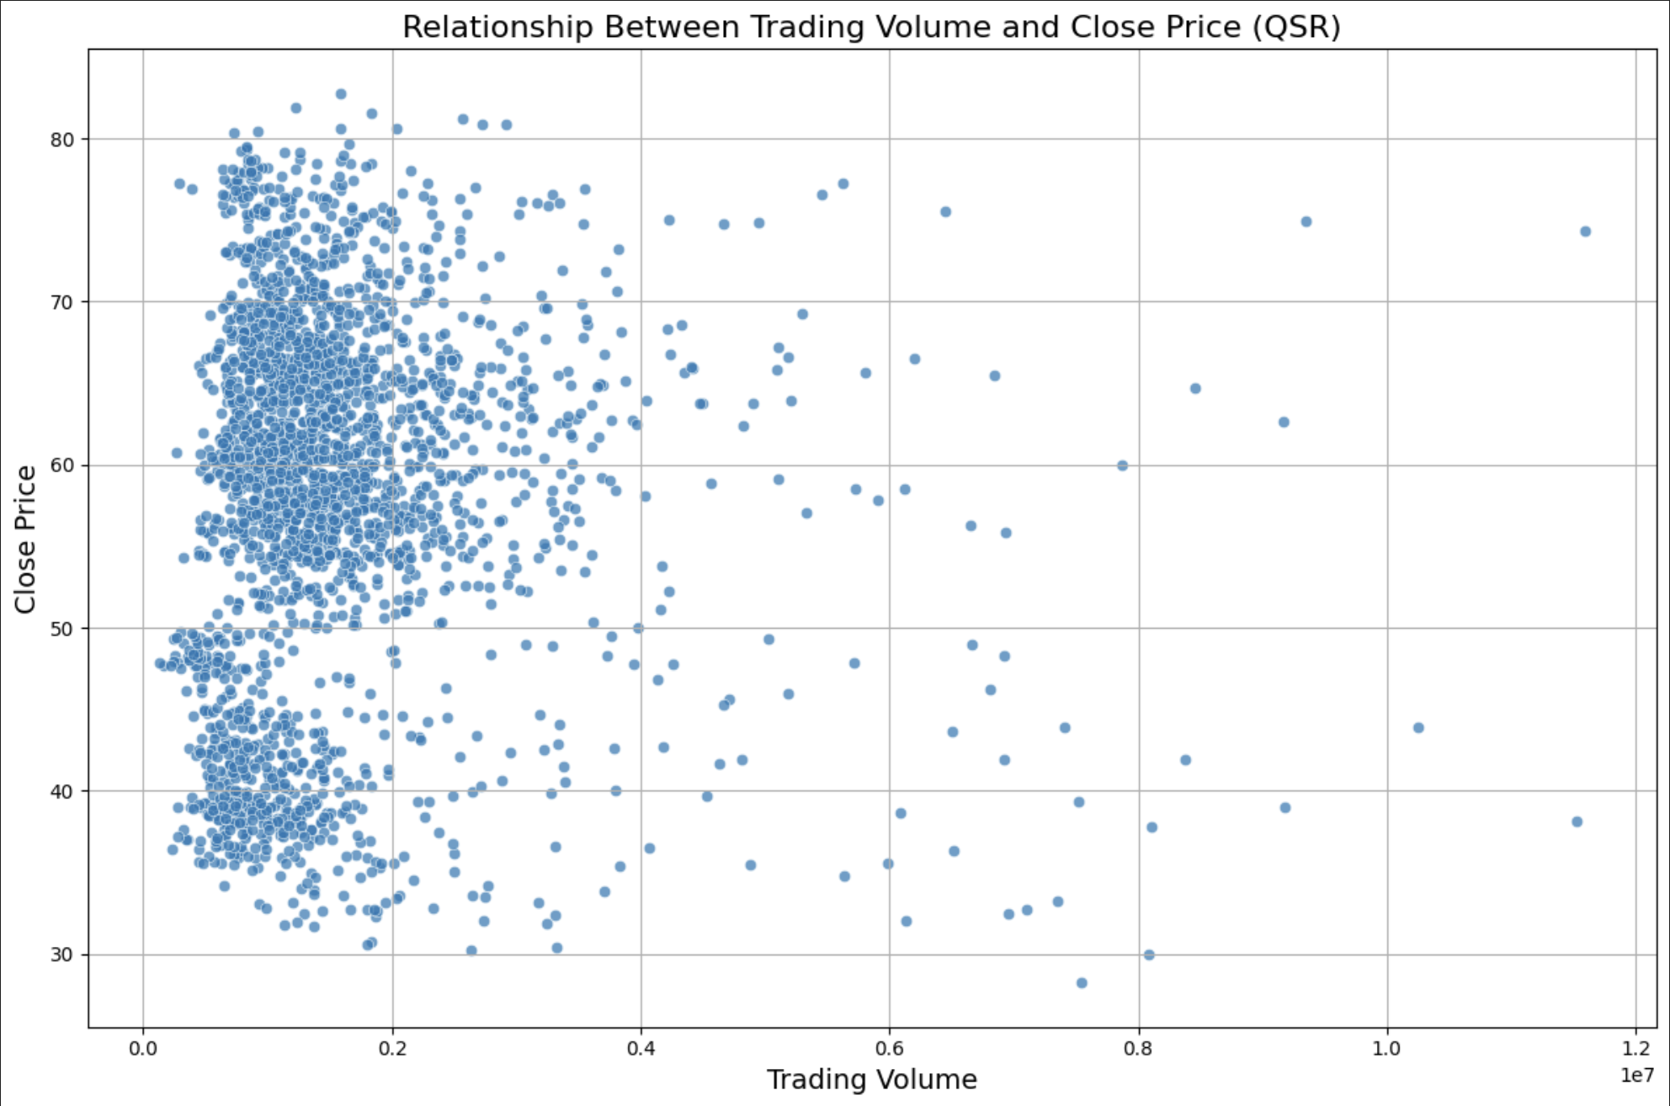
Relationship between Trading Volume and Close Price (QSR)
Why a Scatter Plot
Displays the distribution of trading volume and its corresponding close prices for QSR.
Observations
Clustered Distribution: Close prices are concentrated between $30-$80, with trading volume mostly below $0.4 \times 10^7$.
Volume Spread: Minimal correlation is evident, suggesting price stability regardless of trading volume fluctuations.
Outliers: Few instances of higher trading volumes around $1.0 \times 10^7$, not strongly linked to higher prices.
Implications: Trading volume does not significantly impact QSR's close prices, indicating other factors drive price changes. Highlights price stability within typical trading volumes.

Slide 9
Month with Highest Total Trading Volume
Company | Month | Total Volume
BRK-A | 2010-02 | 11,264,550
DNUT | 2024-03 | 90,788,155
DPZ | 2012-05 | 33,197,200
LKNCY | 2020-06 | 1,446,646,800
MCD | 2006-10 | 426,927,400
PZZA | 1999-12 | 103,559,133
QSR | 2020-03 | 110,310,400
SBUX | 1999-07 | 1,262,235,200
WEN | 2009-06 | 289,392,900
YUM | 2015-10 | 257,632,682

Slide 10
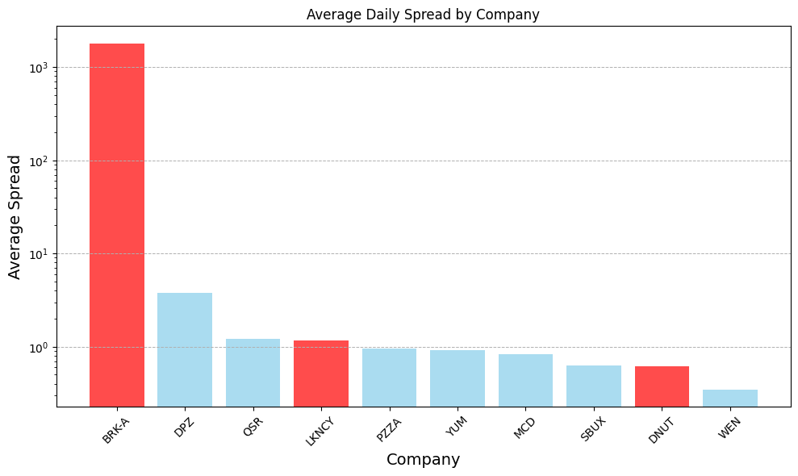
Absolute Average Stock Price Spread per Company
Company | Absolute Spread
BRK-A | 1798.09
DPZ | 3.80
QSR | 1.21
LKNCY | 1.15
PZZA | 0.96
YUM | 0.91
MCD | 0.84
SBUX | 0.63
DNUT | 0.61
WEN | 0.34

Slide 11


Average Stock Price Spread and Average Stock Price Levels
Company | Absolute Spread | Average Stock Price
BRK-A | 1798.09 | 120715.35
DPZ | 3.80 | 157.55
QSR | 1.21 | 58.47
LKNCY | 1.15 | 18.19
PZZA | 0.96 | 31.81
YUM | 0.91 | 49.71
MCD | 0.84 | 51.14
SBUX | 0.63 | 30.89
DNUT | 0.61 | 14.07
WEN | 0.34 | 12.62
Company | Relative Spread
BRK-A | 1.47
DPZ | 2.66
QSR | 2.15
LKNCY | 6.83
PZZA | 3.15
YUM | 2.20
MCD | 2.10
SBUX | 2.86
DNUT | 3.82
WEN | 3.43
Highest absolute average spread seems to correlate with high stock price levels
Relative Values

Slide 12
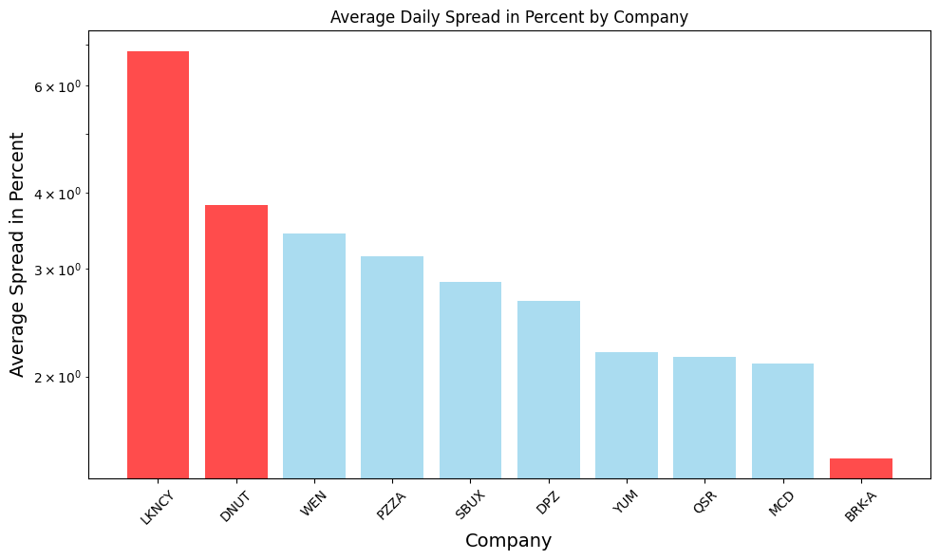
Relative Average Stock Price Spread per Company
Dataset | Relative Spread
LKNCY | 6.83
DNUT | 3.82
WEN | 3.43
PZZA | 3.15
SBUX | 2.86
DPZ | 2.66
YUM | 2.20
QSR | 2.15
MCD | 2.10
BRK-A | 1.47

Slide 13

Thank you for you attention!

